Slide 1
Kamna Malviya MCA 2 SEM
ROOL NO - 14

Slide 2
EC2(Elastic Compute Cloud) EC2, or Elastic Compute Cloud, is a core service provided by Amazon Web Services (AWS) in the field of cloud computing. It offers resizable compute capacity in the cloud, designed to make web-scale computing easier for developers. Here’s a breakdown of what EC2 entails: 1. Virtual Computing Environment: EC2 allows users to rent virtual machines (instances) on which they can run their own applications. These instances can be configured with various CPU, memory, storage, and networking capacities to suit different workload requirements. 2. Scalability: The term "Elastic" in EC2 signifies its scalability feature. Users can easily scale up or down the number of instances they use based on their computing needs. This elasticity allows applications to handle varying workloads and helps optimize costs by only paying for the capacity used. 3. Instance Types: AWS provides various instance types optimized for different use cases, such as general-purpose computing, memory-intensive applications, storage optimized tasks, and more. Each instance type offers specific combinations of CPU, memory, storage, and networking capacity. 4. Pricing: EC2 operates on a pay-as-you-go pricing model, where users pay for the compute capacity they actually consume. Pricing can vary based on the instance type chosen, the region in which it runs, and any additional

Slide 3
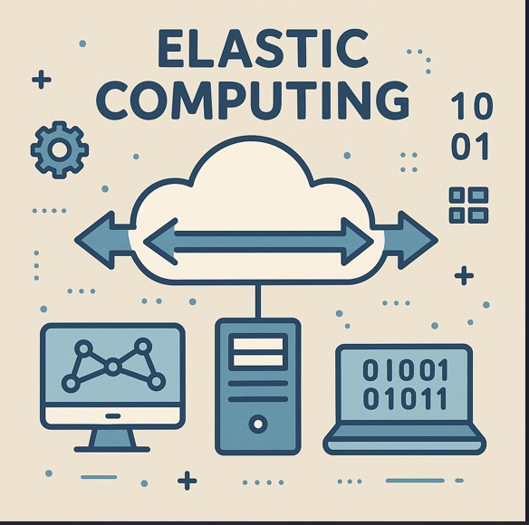

Slide 4
services or features utilized (such as data transfer or storage). 5. Integration with AWS Services: EC2 instances can easily integrate with other AWS services, such as Amazon S3 for storage, AWS Lambda for serverless computing, and Amazon RDS for managed databases. This makes it versatile for building complex architectures and applications. 6. Security: AWS provides a range of security capabilities and options to secure EC2 instances, including virtual private clouds (VPCs), security groups, encryption, and monitoring tools. Users have control over their virtual networks and can configure security settings as per their requirements. 2. Key Features and Concepts Virtual Machines (Instances): • Instance Types: AWS offers a wide range of instance types optimized for different use cases. Each instance type comes with varying combinations of CPU, memory, storage, and networking capacity. For example, there are general-purpose instances, compute-optimized instances, memory-optimized instances, and more. • AMI (Amazon Machine Image): Users can choose from pre-configured or customized AMIs that provide the operating system, application server, and applications required to launch instances.

Slide 5
Elasticity: • Auto Scaling: EC2 instances can be automatically scaled based on conditions defined by the user, such as CPU utilization, network traffic, or time-based schedules. This ensures applications have enough resources during peak times and saves costs during off-peak periods. • Spot Instances: Users can bid for unused EC2 capacity (Spot Instances) at potentially lower costs compared to On Demand instances, suitable for fault-tolerant and flexible applications. Pricing: • Pay-as-you-go: EC2 operates on a pay-as-you-go model, where users are billed for compute capacity by the hour or second (depending on the instance type). There are various pricing options including On-Demand, Reserved Instances (RI), and Savings Plans, each offering different levels of cost savings and commitment. Integration: • AWS Services Integration: EC2 instances can seamlessly integrate with other AWS services such as Amazon S3 (storage), Amazon RDS (relational databases), Amazon DynamoDB (NoSQL databases), AWS Lambda (serverless computing), and more. This facilitates building scalable and complex architectures. Security:

Slide 6
• Security Groups and VPC: EC2 instances are deployed within Virtual Private Clouds (VPCs), allowing users to define a logically isolated network that they control. Security groups act as virtual firewalls to control inbound and outbound traffic to instances. • IAM (Identity and Access Management): Users can manage access to EC2 instances and resources using IAM, defining granular permissions for users, groups, and roles. Monitoring and Management: • Amazon CloudWatch: Provides monitoring and visibility into EC2 instances and other AWS services, enabling users to collect and track metrics, set alarms, and automatically react to changes in performance. • AWS Systems Manager: Offers operational insights and automation for managing EC2 instances at scale, including patch management, configuration management, and task automation. 3. Use Cases EC2 is widely used for various applications and workloads, including: • Web Applications: Hosting websites and web applications with scalable compute capacity. • Big Data Processing: Running Hadoop, Spark, or other big data frameworks for analytics and processing large datasets. • Enterprise Applications: Deploying and scaling enterprise applications and databases.

Slide 7
• Development and Testing: Providing scalable infrastructure for development, testing, and staging environments. • Machine Learning: Training and deploying machine learning models using GPU-accelerated instances. 4. Benefits • Flexibility: Choose from a variety of instance types and configurations based on specific workload requirements. • Scalability: Scale compute capacity up or down instantly to handle changing demands. • Cost Efficiency: Pay only for the resources used, with options for cost savings through Reserved Instances or Spot Instances. • Reliability: Built-in features like Auto Scaling and multiple Availability Zones enhance application availability and fault tolerance. • Integration: Easily integrate with other AWS services for building complex and scalable architectures. In essence, Amazon EC2 provides a robust and flexible platform for deploying virtual servers in the cloud, empowering organizations to innovate, scale, and manage their applications and workloads efficiently. Its comprehensive set of features and integration capabilities make it a cornerstone of AWS's cloud computing offerings.

Slide 8
🏢 Tech Companies
Netflix – Uses AWS to scale video streaming based on demand.
Airbnb – Leverages Amazon EC2 to automatically handle fluctuating traffic.
Spotify – Uses Google Cloud for scalable storage and computing.
Dropbox – Migrated to a hybrid cloud model with elasticity for file sharing.
Zoom – Uses AWS to elastically scale video conferencing capacity.

